Slide 1
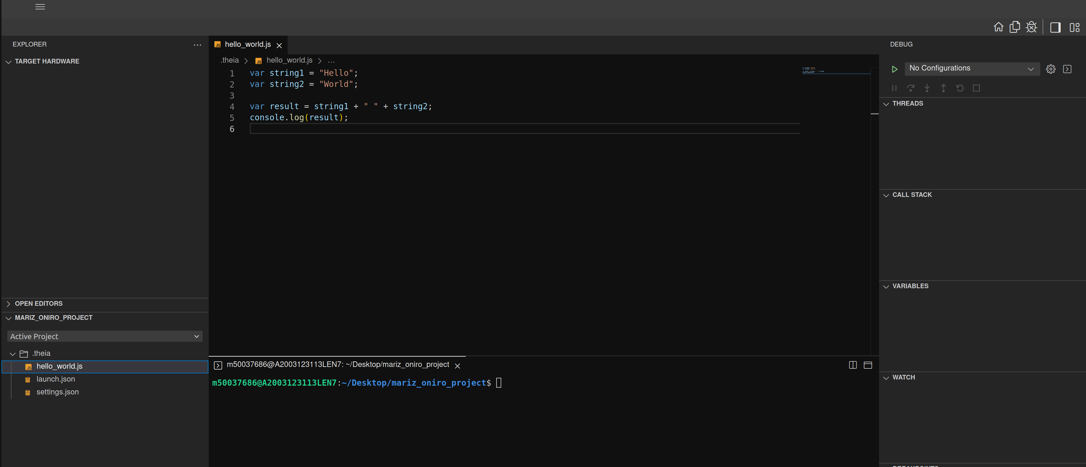
1
Menu Bar
4
Editor Groups
Tool Bar
Layout Bar
2
3
Panel
6
Panel
Debugging Side Bar
5
Primary Side Bar
6
8
7
Status Bar

